Slide 1
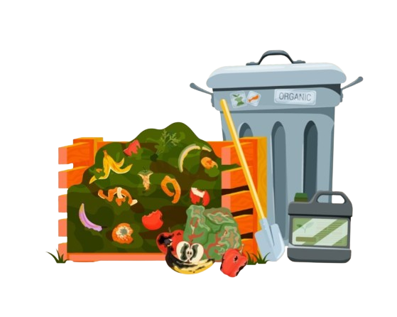
SURPLUS MEAL DROP
AN INNOVATIVE, YET SIMPLE SOLUTION TO REDUCE FOOD WASTE.
-BY CODE NINJAS
MOHAMMAD IZAAN
ARUSH KUMAR
ASMIT KAR

Slide 2


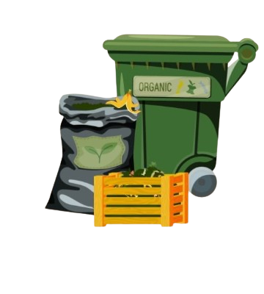


TABLE OF CONTENTS
11
INTODUCTION
OVERVIEW
What is surplus meal drop?
Goal of our project
IMPLEMANTATION
IMPACTS
How to implement the project
Impact of our project

Slide 3
INTRODUCTION
PROBLEM STATEMENT
"Food waste is a significant global issue, with millions of tons of edible
food discarded every year. This waste contributes to environmental
degradation and exacerbates food insecurity.
PURPOSE
"To generate innovative ideas for reducing food waste through a
delivery-based solution that connects surplus food with those in need.

Slide 4
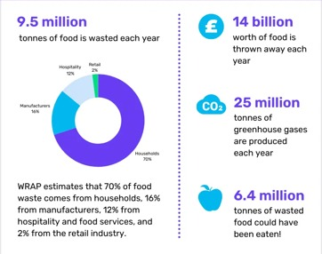
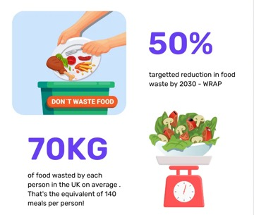
THE PROBLEM OF FOOD WASTE
STATISTICS
IMPACT
Environmental: "Food waste
contributes to greenhouse gas
emissions.“
Social: "Millions go hungry
while edible food is wasted."

Slide 5
POTENTIAL SOLUTIONS
IDEAS
"A mobile app that connects restaurants with surplus food to local
shelters or food banks.“
"A platform that allows individuals to donate excess home-cooked
meals.“
"A logistics solution that optimizes delivery routes for surplus food
distribution.“
TECHNOLOGY INVOLVEMENT
"AI for predicting surplus food availability.“
"Blockchain for transparency in food distribution.“

Slide 6
THE OPPURTUNITY
MARKET GAP
"Despite existing food delivery services, there is a lack of efficient
systems that address food waste.“
POTENTIAL IMPACT
"Reducing food waste through delivery solutions can benefit both the
environment and society."

Slide 7
OVERVIEW
GOAL
"To brainstorm and develop actionable ideas for surplus food delivery system.“
PARTICIPANTS
"Open to innovators, developers, NGOs, and food industry
professionals.“
CRITERIA FOR SUCCESS
"Feasibility, sustainability, scalability, and impact."

Slide 8
IMPLEMENTATION STRATEGY
STEPS FOR DEVELOPING THE IDEA
"Research and data collection on food waste sources.“
"Building partnerships with restaurants, grocery stores, and NGOs.“
"Development of a user-friendly platform.“
PILOT PROGRAM
"Start with a small-scale pilot in a local community to test the concept.“

Slide 9
CHALLENGES AND SOLUTIONS
CHALLENGES
"Food safety regulations.“
"Logistics and delivery costs.“
"Awareness and user adoption.“
PROPOSED SOLUTIONS
"Collaborate with local health departments for safety compliance.“
"Use volunteers or partner with existing delivery services.“
"Awareness campaigns through social media and community
engagement.“

Slide 10
IMPACT AND BENIFITS
ENVIRONMENTAL IMPACT
"Reduction in landfill waste and greenhouse gas emissions.“
SOCIAL IMPACT
"Increased access to food for those in need.“
ECONOMIC IMPACT
"Cost savings for restaurants and potential job creation in logistics."

Slide 11


THANK YOU
“Let's work together to
reduce food waste and
make a positive impact on our world.”

